Slide 1

ADO Making it Work for you!
Presented for Development Community

Slide 2
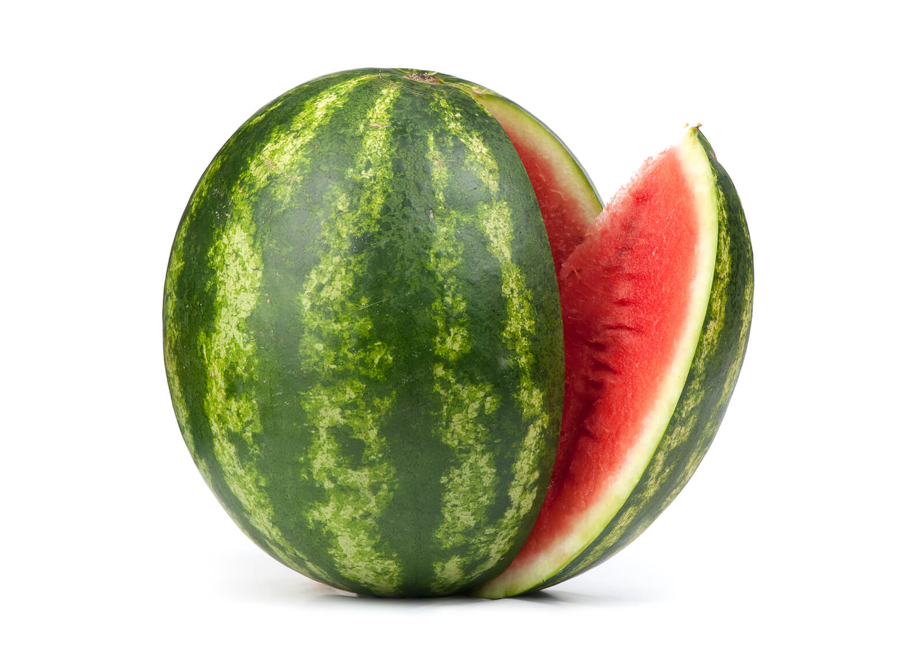
Why
Take Away
Change/Transformation is happening and possible
Importance of Transparency
Tips on configuring ADO

Slide 3
Agenda
Agile Strategy for CPPe
Goals
Benefits
ADO Walkthrough
Project vs Product
Work Item hierarchy and relationship
Area & Iterations
Teams
Backlog, Boards, Sprints
Queries
Dashboard (Transparency/Visibility)

Slide 4

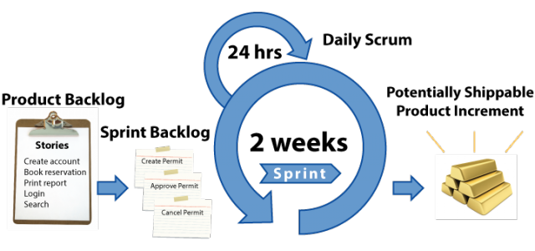
Our Goals for CPPe
Project Governance
Follow SCRUM
Business is the Product Owner
Dev Teams are Cross Functional
Business and IT working together daily
Improve Project Governance ability to coordinate and manage project artifacts and deliverables
Start small and scale progressively
Business
Products
Feature Team
IT

Slide 5
Team Structure
Public Web
Cross-Functional Teams
Help with delivery
Reduce Dependencies
Reduce Handoffs
Increase skills/knowledge
Increase
Internal Web
Business Services
Data Services
Stored Procedures
Data

Slide 6
Benefits seen
Engagement
Knowledge
Language is changing
Trust

Slide 7
ADO

Slide 8
DEMO

Slide 9

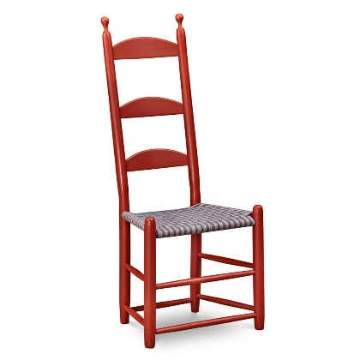






Projects VS Products
Notes:
Projects
Short lived
Way to get funding
Realization of New ideas, legislative changes
We use them to create or enhance our Products
All Projects should leave the product in a better state (Scouts – leave campsite cleaner then when u got there)
Success focuses on Timeline and Costs
Products
Something that is created through a process and that provides benefits to a market or to address a market need.​
Chair (design, cut, sand, build)​
MS Office (design, code, test, deploy)​
Consulting service (document, session, workshop)​
Could have sub-products (pre-milled legs)​
Long-Lived (beyond the projects)
Without it an organization cannot
Focus its strategy and Market its product appropriately
Identify its owner, teams, roles​ and responsibility
Create a backlog
Success focuses on business outcome and the value given to the customer
Devs and Testers are assigned to the product

Slide 10
OAS
CPP
To Succeed
Workload Management
Prioritization
Product Structure
Team Structure
Impacts
Unable to satisfy business/customer needs efficiently
Reduced flow
Complex coordination
Complex IT
Code branching/merging
Technical debt takes a back seat
Cost Increase
OAS Pension
GIS
Allowance
Allowance for Survivor
Children’s
Post-Ret-Dis
Survivor
Retirement
Disability
Death
Technical Debt
Post-Ret
BDM
OAS-SIS
CPP-SIS
CPP-D
CPP-E
Citizen Portal
Pension Benefits Management
Retirement Planning
Retirement Income Calculator
Agent Portal
Adjudication
Rules Based Reassessment System
Benefits Finder
Payments
Notes:
Funnel effect needs to be brought higher and in business
Do smaller projects
20% of project A, 10% of project B….
To Succeed
Workload Management
Prioritization
Product Structure
Team Structure
Impacts
Unable to satisfy business/customer needs efficiently
Reduced flow
Complex coordination
Complex IT
Code branching/merging
Technical debt takes a back seat

Slide 11
Work Items Hierarchy
Project
Epic
Feature
Feature
Feature
Feature
User Story
User Story
User Story
User Story
User Story
Product
Task
Task
Task
Task
Task
Task
Task
Task
Task
Test Case
Test Case
Test Case
Test Case
Test Case
Test Case
Test Case
Test Case
Test Case
Notes:
Keep Title short and precise
“As a [who], I want [what], so that I can [why]” goes in the description
This makes it easier to read in the boards
Tip: Create your links via the “+” in the backlog

Slide 12
Areas and Iterations
Areas
Represents slices of your product
Shouldn’t change from project to project
Examples
Public Web, Internal Web, backend
Intake, Adjudication, Payment
Job Search, Job Monitoring, Employer Job Posting
Iterations
Represent time-related items (sprints, milestones)
Shows when work is being addressed
Creates a “Sprint”
Examples:
Sprint 10, 11, 12
Modify Gender field
Sprint 2
Benefit X
Sprint 3, 4
Benefit Y
Sprint 5, 6, 7
Don’t
Use them to identify when something happened (bug)
Use them for environments (systest, UAT)
Avoid using numbers (rel 1, 2, 3) the order will change
Avoid using project milestone (they are all product increment… tags can be used to highlight projects)

Slide 13
Teams
Represents your teams structure
Examples: Blue Team, Green Team, UI Team, DB Team
Get their filtered spaces in ADO
Based on the Area and Iteration configured for them
Can be used for escalation/impediment tracking
Links back to your items

Slide 14
Backlog, Boards, Sprints
Backlog
All the work
Boards
Work filtered by team, area, iteration
Views: Feature Timeline, Epic Roadmap
Sprints
Work filtered Sprint (Iteration) team, area
Views: Taskboard, Backlog, Capacity

Slide 15
Queries
Backbone of your dashboards
Can span over to other ADO projects
Recommended folder structure (All, By Area, By Team, by Iteration)
@currentIteration

Slide 16
Dashboards
Making the tool work for you!

Slide 17
Using ADO following SCRUM
Grooming
Use Backlog
Sprint Planning
Daily Standup
Sprint Close
Sprint Start
Refine WI content for future sprints
Prioritization
Create “Iteration”
Create Queries and Dashboards
Commit work to sprint by setting “Iteration”
Review/Set Story Points
Use Teams Board
Ensure WIs are up to date
Ensure WIs are up to date
Move/Split WIs not completed to backlog
Review WI
On going activity for business
Planned activity with Dev
Use Backlog
(Includes any type of Bugs)

Slide 18
Using ADO for Bug (Traditional Testing)
Raise
Create Bug
Addressing
Re-Test
Triage
Review Bug content
Commit work to sprint by setting “Iteration”
To Set
Description
To be prioritize at Backlog Grooming
Once addressed to set:
Comments
If not successful set status back to “Active”, and it will go back to Triage
“Integrated In” field
Severity
Found in Build
Don’t Set
Status Resolved
Iteration
…
If successful set status to “Closed”
Build/Deploy
Create missing automated tests
Notes:
In SCRUM, dev teams don’t raise bugs, testing and the successful implementation prevents a Story from being “closed” until it is fully functional.
NOTE:
-If a bug fix allows you to get further in your application and you find another issue. Raise this new discovery as a new bug!
-setting status to “resolved” will impact your teams velocity rating, as items in your sprint would not be “closed” and therefore will not count.

Slide 19
Parent ADO Models
Separate Parent
Integrated Parent
Parent ADO
Parent & Product X ADO
Epic
Epic
Epic
Epic
Epic
Epic
Product X ADO
Product Y ADO
Product Y ADO
Feature
Feature
Feature
Feature
Feature
Feature
Feature
Feature
User Story
User Story
User Story
User Story
User Story
User Story
User Story
User Story
User Story
User Story

Slide 20
Annex

Slide 21
Doing vs Being
Mindset
Less Visible
More Powerful
Values
Principles
Doing vs Being
Culture Shift!
Practices
Tools
More Visible
Less Powerful
Adapted from Agile Onion by AWA, Simon Powers
Notes:
Example: Cargo Cult

Slide 22
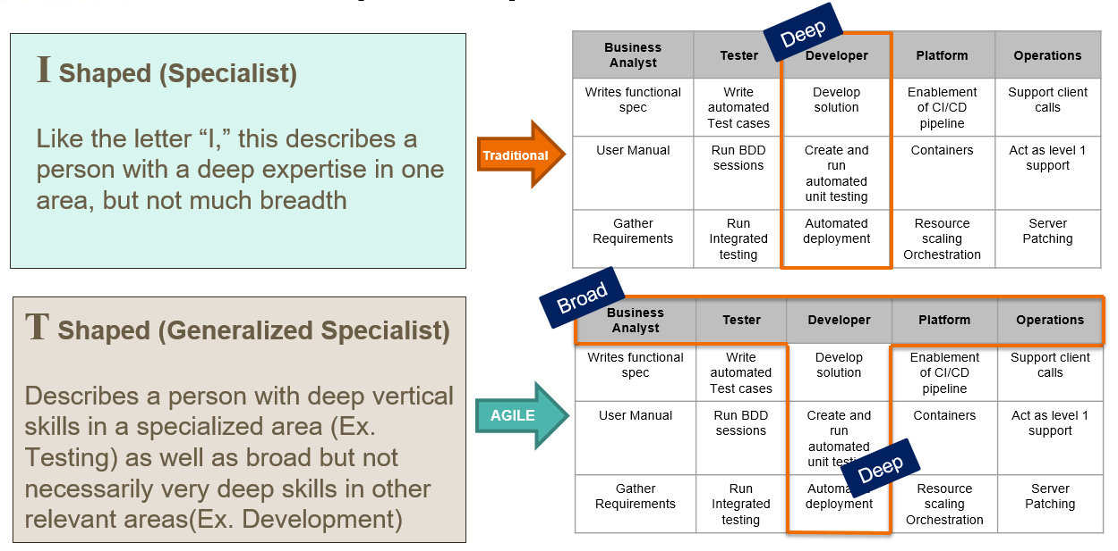
Team Structure
Notes:
Industry Trends and DevOps show that people to be more broad skilled.

Slide 23
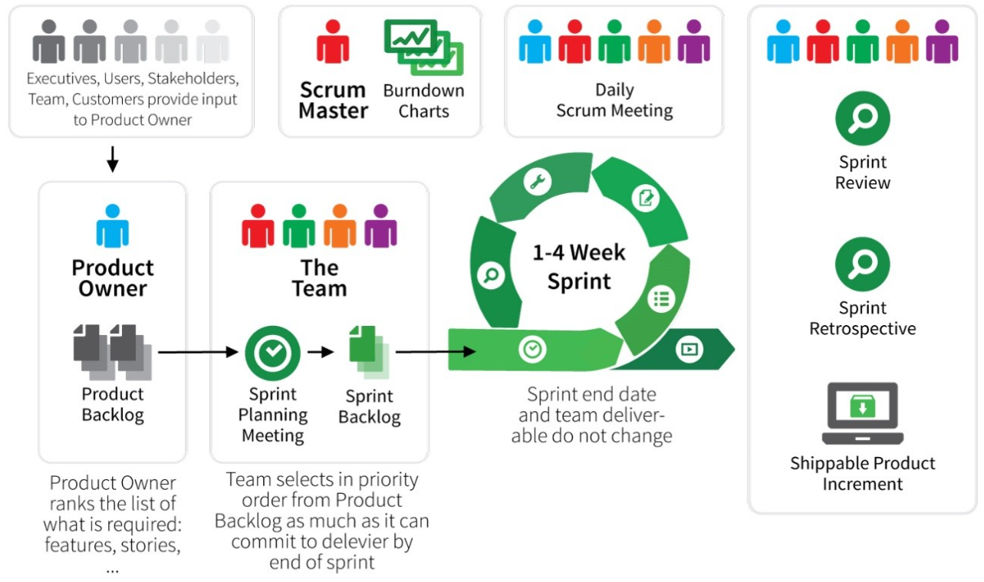



SCRUM at a Glance
Sprint 0
Define Product Roadmap, Team Agreements and Strategies, High Level Architecture, cross functional teams, funding, Initial Backlog

Slide 24
ADO
CPP-SIS Project
Project Governance Team
Impacted Products
MSCA
Pensions
YY
Choose MSCA as Parent ADO
Create Project Epics in MSCA ADO
Create Features/Stories in Appropriate Product ADO
Link All Features back to Parent MSCA ADO
Project Reporting managed in Parent MSCA ADO
Project needs read access to product ADOs
Use “Iteration” to filter work for project
MSCA Backlog
Pensions Backlog
Parent ADO
+ Impacted Product ADO
Contains:
CPP-SIS Project Reporting
CPP-SIS Project Epics
Features/Stories for MSCA changes
Impacted Product ADO
Contains:
Features/Stories for Pension changes
Features are linked to Parent ADO Epics

Slide 25
The Importance of the PO
There for the duration of the product!
Acts as the connector
A person, not a committee
Bridge between Business and IT
Maximizes value of a product
Sole responsibility of managing the backlog and Dev Team
Must be transparent
WHO: IT or Business?
SCRUM Team
“The business and developers must work together daily”
Notes:
The role of product owners evolved out of the roles of project manager, business subject matter expert (SME) and project sponsor from the waterfall environment.
Acts as the connector:
Dev Team
Work daily together
Build/Enhances the product for the PO
PO provides what to build/enhance and its priorities
PO is the only one that assigns work to the Dev team
Scrum Master
Work daily together
Relationship relates to PO knowledge and behavior.
SM needs to know the PO’s concerns, questions, and obstacles to help.
SM educate/coach PO and Team on Agile Mindset and principles to continually improve and deliver value
Customers/Users
The product is built for them, therefore:
PO needs to know their goals and real issues
PO uses their real feedback to prioritize work and create the best product for them
Stakeholders
Project Sponsors, Architecture
They provide the organizational vision/mandates/objectives and set direction
They should view the PO as having the final accountability and responsibility for product success.
PO is responsible for making the development status visible
PO is responsible for realizing Stakeholders desired impacts (e.g., ROI and market share).
A person, not a committee
may represent the desires of a committee
Has the authority and delegation to make decisions
to succeed, the entire organization must respect the POs decisions.
Bridge between business and IT
Language barriers
Both need each other, business needs IT to build, IT needs requirement to build
Manages expectations of both
Responsible for maximizing value of a product
Based on objectives, feedback of all parties
Sole responsibility of managing the backlog and Dev Team
those wanting to change a Product Backlog item’s priority must address the Product Owner
Include bugs and technical debt
In the waterfall model of projects, each of these roles provided different levels of direction, management and leadership. The project manager is the administrator. The SME provides information on what is done today and what they will need in the future. The sponsor’s role includes providing resources, framing the scope of the project, providing direction as the project moves forward and to demand that the project delivers. The sponsor and the project manager are generally the outsiders that exhort the team into action . . . they act as drill sergeants. While classic project management techniques often include a role similar to a drill sergeant, Scrum and other Agile frameworks actively eschew this role. The Agile principle that states that “the business and developers must work together daily” suggests shedding the approach of an outsider exhorting the team, and implementing the concept of the product owner as leader within the team."

Slide 26
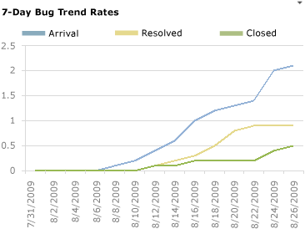
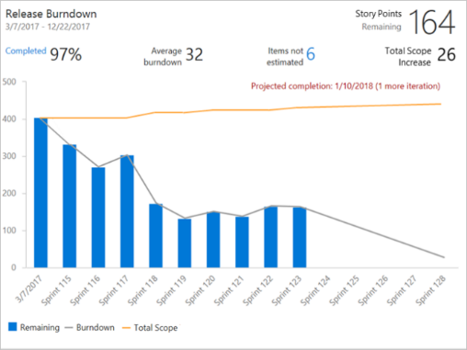
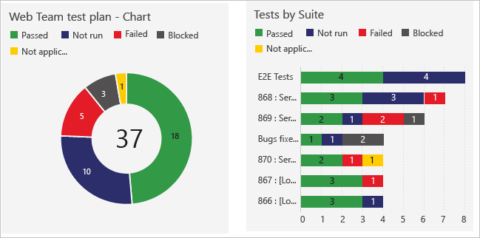
Transparency/Visibility
VS
“Working software is the primary measure of progress”
Notes:
Watermelon Analogy: Applies to IT projects where status reports show green, when really hiding it’s true issues, risks and concerns.
The lack of metrics on work to do, in progress and done, lack of feedback and our waterfall model promotes this.
A lot of time is wasted in creating and gathering the information for the status report, often creating extra resources or taken time away from the product (where value is given). To then make decisions based on the unknown or inaccurate information.
Business (PO) is now embedded in team and in dev activities, they are on the floor and therefore has a much greater knowledge of the work and its progress.
The use of Backlog and boards (scrum, Kanban, wall) show work done, in progress and to do. Shows dependencies that may lead in impediments.
Show order/priority of work. Helps discussions and collaboration.
Charts show factual information, velocity, burn down rates, issues tested etc…

